Slide 1
Testing Concepts

Slide 2
Version Control and Revision History
 | Name | Date
Prepared By | Sneha Kumar | 07-Mar-2019
Reviewed By | Manisha Mane | 07-Mar-2019
Approved By | Nisha Mendonsa | 07-Mar-2019
Version No. | Date | Section Affected | Highlight of Changes
1.0.0 | 07-Mar-2019 | All | Original Version.

Slide 3








Iconic Representations.......
Test your Memory
Can you Solve?
Objective
Coffee Break
Queries
Recap
Need more Info
Brainstorm

Slide 4
What is software Testing?
In Software Testing it is not sufficient to demonstrate that the software is doing what it is supposed to do.
In Software Testing it is more important to demonstrate that the software is not doing what it is not supposed to do.
Software testing can also be stated as the process of validating and verifying that a software program/application/product works as expected according to the business and technical requirements.
Works consistently and predictably.
Process of finding defects i.e. variance between Expected results and Actual results.
Process of executing a software program application with intent of finding errors.

Slide 5
Why is Testing necessary?
Software Testing is necessary to make sure the product or application is defect free, as per customer specifications.
Software Testing identifies faults whose removal increases the software quality and increases the software's reliability.
Software Testing is important as it may cause mission failure, impact on operational performance and unreliable if not done properly
Software Testing is important to make sure that the software is
Error Free
Efficient
Secured
More complex the program, more the testing effort is required.
Testing effort is directly proportional to the complexity of the program.

Slide 6
When to Start Testing?
Testing starts right from the requirements phase and continues till the release time.
Objective of starting early: Requirements related defects caught later in the SDLC result in higher cost to fix the defect.
When to Stop Testing?
Test cases executed with acceptable percentage of defects
Project Deadlines e.g. release deadlines, testing deadlines
Test budget has run out.
Coverage of code, functionality or requirements reaches to specific point
Bug rate falls below acceptable level

Slide 7
Common problems in the software development process
Poor Requirements – unclear, incomplete, too general
Unrealistic Schedule – If too much work is crammed in too little time, problems are inevitable.
Inadequate testing – No one will know whether or not the program is any good till the customer complaints or system crashes.
Features –A request to pile on new features after development is underway; extremely common.
Miscommunications – If developers don’t know what’s needed or customers have erroneous expectations, problems are guaranteed

Slide 8
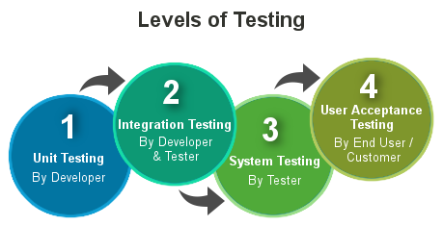
Levels Of testing

Slide 9
Participants In Testing
Customer
User
Developer
Tester
Auditor

Slide 10
Best Practices in Testing
Test Planning
Code Testability
Test often
Test early
Measure test costs, coverage, results and effectiveness.
Negative Testing: Needs Kick the wall approach

Slide 11
7 ISTQB Testing Principles
Exhaustive testing is not possible:
Testing everything (all combinations of inputs and preconditions) is not feasible except for trivial cases. Instead of exhaustive testing, risk analysis and priorities should be used to focus testing efforts
Defect Clustering:
Defect Clustering which states that a small number of modules contain most of the defects detected. This is the application of the Pareto Principle to software testing: approximately 80% of the problems are found in 20% of the modules. By experience, you can identify such risky modules
Pesticide paradox:
If the same set of repetitive tests are conducted, the method will be useless for discovering new defects. To overcome this, the test cases need to be regularly reviewed & revised , adding new & different test cases to help find more defects.

Slide 12
Testing shows presence of defects:
Testing can show that defects are present, but cannot prove that there are no defects. Testing reduces the probability of undiscovered defects remaining in the software but even if no defects are found, it is not a proof of correctness
Absence–of–errors fallacy:
It is possible that software which is 99% bug-free is still unusable. This can be the case if the system is tested thoroughly for the wrong requirement. Software testing is not mere finding defects, but also to check that software addresses the business needs
Early Testing:
Testing should start as early as possible in the Software Development Life Cycle. So that any defects in the requirements or design phase are captured in early stages. It is much cheaper to fix a Defect in early stages of testing
Testing is context dependent:
Testing is done differently in different contexts. For example, safety – critical software is tested differently from an e-commerce site.

Slide 13
Skills required for Testing
Strong desire for quality and attention to detail.
Ability to understand the point of view of the customer.
Tact and diplomacy for maintaining the cooperative relationship with developers.
Ability to communicate with both technical and nontechnical people.
Judgment skills are needed to assess high risk areas of an application on which to focus testing efforts when time is limited.
‘Test to break’ attitude.

Slide 14
Software Development Life Cycle(SDLC)
Software Development Life Cycle(SDLC) is a process used by software industry to design, develop and test high quality software's.
The SDLC aims to produce a high quality software that meets or exceeds customer expectations, reaches completion within times and cost estimates.
The SDLC consists of a detailed plan describing how to develop, maintain, replace and alter or enhance specific software.
The life cycle defines a methodology for improving the quality of software and the overall development process.

Slide 15
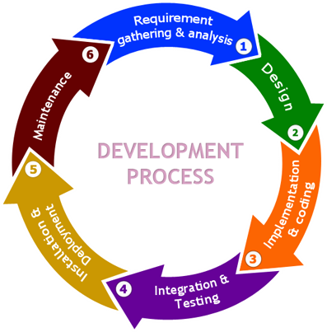
Phases in SDLC

Slide 16
Different phases of Software Development Cycle | Activities performed in each stage
Requirement Gathering stage | Gather as much information as possible about the details & specifications of the desired software from the client. This is nothing but the Requirements gathering stage.
Design Stage | Plan the programming language like java,.net; database like Oracle, MySQL, etc. Which would be suited for the project, also some high-level functions & architecture.
Build Stage | After design stage, it is build stage, that is nothing but actually code the software
Test Stage | Next, you test the software to verify that it is build as per the specifications given by the client.
Deployment stage | Deploy the application in the respective environment
Maintenance stage | Once your system is ready to use, you may require to change the code later on as per customer request

Slide 17
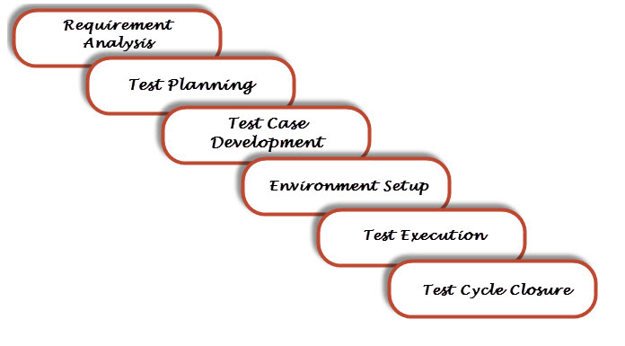
Software Testing Life Cycle
STLC: Software Testing Life Cycle (STLC) is defined as a sequence of activities conducted to perform Software Testing.
Different stages in Software Test Life Cycle

Slide 18
Software Testing Life Cycle
Phase | Activity | Deliverables
Requirements/Design Review | Identify types of tests to be performed. Gather details about testing priorities and focus. Prepare Requirement traceability matrix Identify test environment details where testing is supposed to be carried out. Automation feasibility analysis (if required). | RTM Automation feasibility report. (if applicable)
Test Planning | Preparation of test plan/strategy document for various types of testing Test tool selection Test effort estimation Resource planning and determining roles and responsibilities. Training requirement | Test plan / strategy document. Effort estimation document.
Test Case Development | Create test cases, automation scripts (if applicable) Review and baseline test cases and scripts Create test data (If Test Environment is available) | Test cases/scripts Test data

Slide 19
Software Testing Life Cycle
Phase | Activity | Deliverables
Test Environment | setup the test environment (server/ client/ network, etc) with the goal of replicating the end-users’ environment. | Test Environment
Test Execution | Execute tests as per plan Document test results, and log defects for failed cases Map defects to test cases in RTM Retest the Defect fixes Track the defects to closure | Completed RTM with execution status Test cases updated with results Defect reports
Test Cycle Closure | Evaluate cycle completion criteria based on Time, Test coverage,Cost,Software,Critical Business Objectives , Quality Prepare test metrics based on the above parameters. Document the learning out of the project Prepare Test closure report Qualitative and quantitative reporting of quality of the work product to the customer. Test result analysis to find out the defect distribution by type and severity. | Test Closure report Test metrics

Slide 20
SDLC
SDLC is Software Development Life Cycle. It is the sequence of activities carried out by Developers to design and develop high-quality software.
Though SDLC uses the term ‘Development’, it does not involve just coding tasks done by developers but also incorporates the tasks contributed by testers and stakeholders.
In SDLC, test cases are created.
STLC
STLC is Software Testing Life Cycle. It consists of series of activities carried out by Testers methodologically to test your software product.
Though STLC uses the term “testing” it does not involve just testers, at some instances, they have to involve developers as well.

Slide 21
QA,QC and Testing
Most people get confused when it comes to pin down the differences among Quality Assurance, Quality Control, and Testing
The following table lists the points that differentiate QA, QC, and Testing.
Quality Assurance | Quality Control | Testing
QA includes activities that ensure the implementation of processes, procedures and standards in context to verification of developed software and intended requirements. | It includes activities that ensure the verification of a developed software with respect to documented (or not in some cases) requirements. | It includes activities that ensure the identification of bugs/error/defects in a software.
Focuses on processes and procedures rather than conducting actual testing on the system. | Focuses on actual testing by executing the software with an aim to identify bug/defect through implementation of procedures and process. | Focuses on actual testing.
Process-oriented activities. | Product-oriented activities. | Product-oriented activities.
Preventive activities. | It is a corrective process. | It is a preventive process.
It is a subset of Software Test Life Cycle (STLC). | QC can be considered as the subset of Quality Assurance. | Testing is the subset of Quality Control.

Slide 22
What is Manual Testing?
Manual Testing is a type of Software Testing where Testers manually execute test cases without using any automation tools.
Manual Testing is the most primitive of all testing types and helps to find bugs in the software system.
Any new application must be manually tested before its testing can be automated. Manual Testing requires more effort, but is necessary to check automation feasibility.
Manual Testing does not require knowledge of any testing tool.
One of the Software Testing Fundamental is "100% Automation is not possible".
This makes Manual Testing imperative.

Slide 23
What is Automation Testing?
Automation Testing means using an automation tool to execute your test case suite.
The automation software can also enter test data into the System Under Test, compare expected and actual results and generate detailed test reports. Test Automation demands considerable investments of money and resources.
Using a test automation tool, it's possible to record this test suite and re-play it as required. Once the test suite is automated, no human intervention is required.
The goal of Automation is to reduce the number of test cases to be run manually and not to eliminate Manual Testing altogether.

Slide 24
Automation Testing Vs. Manual Testing
Parameter | Automation Testing | Manual Testing
Definition | Automation Testing uses automation tools to execute test cases. | In manual testing, test cases are executed by a human tester and software.
Processing time | Automated testing is significantly faster than a manual approach. | Manual testing is time-consuming and takes up human resources.
Exploratory Testing | Automation does not allow random testing | Exploratory testing is possible in Manual Testing
Initial investment | The initial investment in the automated testing is higher. Though the ROI is better in the long run. | The initial investment in the Manual testing is comparatively lower. ROI is lower compared to Automation testing in the long run.
Reliability | Automated testing is a reliable method, as it is performed by tools and scripts. There is no testing Fatigue. | Manual testing is not as accurate because of the possibility of the human errors.
UI Change | For even a trivial change in the UI of the AUT, Automated Test Scripts need to be modified to work as expected | Small changes like change in id, class, etc. of a button wouldn't thwart execution of a manual tester.
Investment | Investment is required for testing tools as well as automation engineers | Investment is needed for human resources.
Cost-effective | Not cost effective for low volume regression | Not cost effective for high volume regression.
Test Report Visibility | With automation testing, all stakeholders can login into the automation system and check test execution results | Manual Tests are usually recorded in an Excel or Word, and test results are not readily/ readily available.

Slide 25
VERIFICATION
TESTING -5

Slide 26
Verification
In verification software work products are examined manually or with a set of tools, but not executed
Verification also known as quality assurance.
Verification typically involves reviews and meetings to evaluate documents, plans, code, requirements and specifications.
It determines consistency, correctness and completeness of Program at each stage.
Verification checks whether we are building the product right.
Also called as “static testing”.
Helps in identifying not only the defects but also their location
It starts early in the and so it is done during the Verification Process

Slide 27
Techniques of Verification
Audits
Internal: Done by the organization
External: Done by people external to the organization to check the standards and procedures of project
Review
Typically used to find and eliminate errors or ambiguities in documents such as requirements, design, test cases, etc.
Walkthrough
Technical Review
Inspection

Slide 28
Objectives of Reviews:
Finding defects
Informational, communicational and educational whereby participants learn about the content of the software work products to help them understand the role of their work and plan for future stages of development
Represents project milestones
Support establishment of a baseline for a software products
Gathering Customer Feedback

Slide 29
Categories of Review
Formal Review:
A review characterized by documented procedures and requirement
Informal Review:
A review not based on formal procedure ,not documented

Slide 30
Roles & Responsibilities
Moderator
Author
Scribe
Reviewers
Manager

Slide 31
Moderator
Leads the review process
Determine type of review, approach, composition of review team
Performs entry check & follow up rework
Schedule the meeting, leads possible discussions, coaches the team, stores data that is collected
Author
Writer of the document under review
Goal is to learn as much as possible to improve the quality of future documents
Author’s task is to illuminate unclear areas & to understand the defects found

Slide 32
Scribe
During logging meeting, the scribe(recorder) has to record each defects mentioned and any suggestions for process improvement
Normally author plays this role ensuring log is readable and understandable
However some one other than author can take the role of scribe(eg Moderator) can have significant advantages
Reviewer
The task of the reviewers (also called checkers or inspectors) is to check any material for defects, mostly prior to the meeting.
In addition to the document under review, the material reviewers receive includes source documents, standards, checklists, etc.
The level of domain knowledge or technical expertise needed by the reviewers also depends on the type of review.

Slide 33
Manager
The manager is involved in the reviews as he or she decides on the execution of reviews, allocates time in project schedules and determines whether review process objectives have been met.
The manager will also take care of any review training requested by the participants.
Of course a manager can also be involved in the review itself depending on his or her background, playing the role of a reviewer if this would be helpful.

Slide 34
Types of InFormal Review
Walk through
The author of the document under review guiding the participants through the document process to achieve common understanding and collect feedback
Meeting is led by the author, often separate scribe is present
Scenarios and dry runs may be used to validate the content
Separate Pre-meeting preparation for reviewers is optional
Open-ended sessions
Conducted to explain (knowledge transfer) and evaluate the contents of the document
Conducted to establish a common understanding of the document

Slide 35
Types of Formal Review
Technical Reviews
Discussion activity that focuses on technical contents of the documents
It is often performed as a peer review without management participation.
Ideally it is led by a trained moderator, but possibly also by a technical expert.
Inspections
Most formal review in which documents are prepared and checked thoroughly by reviewers before the meeting, comparing the work product with its source and reference documents.
help the author to improve the quality of the document under inspection.
learn from defects found and improve processes in order to prevent similar defects.

Slide 36
Benefits of Verification
Increases productivity
Increases quality
Reducing no of defects early in the life cycle
Less time to spent on testing and maintenance
Effort and cost for Rework are low
Verification contribute to an increased awareness of quality issues.

Slide 37
Validation
TESTING -5

Slide 38
Validation
Validation typically involves actual testing and takes place after the verifications are complete.
Validation determines the correctness of a final build with respect to its requirements.
Validation checks whether we have built the right product.
Is a disciplined approach to evaluate whether the final product fulfills its specific intended use.
Are we doing the right job?
Also called as “dynamic testing”.
Done by systematically testing a software product with the intention of finding defects.
Helps in identifying presence of the defects, not their location

Slide 39
TEST LEVELS
TESTING -3

Slide 40
TEST LEVELS
UNIT TESTING
INTEGRATION TESTING
SYSTEM TESTING
ACCEPTANCE TESTING

Slide 41
Unit Testing
Test individual modules for its logic
Tests the functionality of units
White Box Testing is involved
Earlier Identification of defects reduces rework and cost
Typically done by the developers and not by testers.
It is typically used to verify control flow, data flow and memory leak problems.

Slide 42
Integration testing
Integration testing is the phase of software testing in which individual software modules are combined and tested as a group.
Follows unit testing and precedes system testing.
Focuses on design and construction of software architecture.
The different types of integration testing :
Big Bang
Incremental Integration

Slide 43
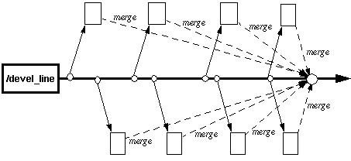
BIG BANG APPROACH
Big – Bang Integration
After all of the modules are tested they are all integrated together at once and tested

Slide 44
Disadvantages
We need to wait until all the modules are developed and unit Tested
It is difficult to Trace the cause of Failures with the late integration

Slide 45
Incremental Testing
All programs are integrated one by one and a test is carried out after each step
Advantages:
Easy to track the source of Defect
Disadvantage:
Time consuming since stubs and drivers have to be developed and used in the test

Slide 46
Categories under Incremental
Top Down
Modules tested in isolation are the modules which are at the highest level
Do this until all subsystems are incorporated into the test
Requires stub modules to simulate the functions of the missing modules that may be called
However, drivers are not needed since we are starting with the modules which is not used by any other module and use already tested modules when testing modules in the higher levels

Slide 47
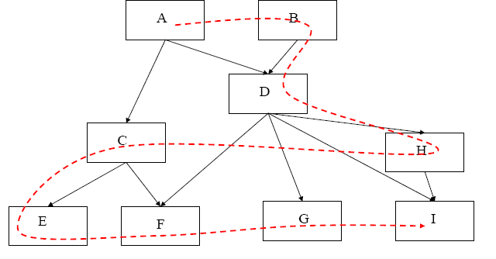
Top-down Integration

Slide 48
Bottom-Up Integration
Only terminal modules are tested in isolation
Modules at lower levels are tested using the previously tested higher level modules
This is done repeatedly until all subsystems are included in the testing
Requires a module driver for each module to feed the test case input to the interface of the module being tested
However, stubs are not needed since we are starting with the terminal modules and use already tested modules when testing modules in the lower levels
Disadvantage: Tests the most important subsystem last

Slide 49
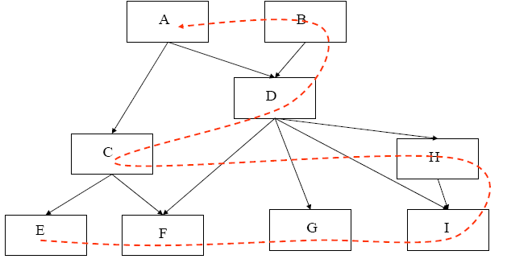
Bottom-Up Integration

Slide 50
System Testing
System Testing helps to confirm that the product meets the requirements as per system specification.
System testing is performed when the entire system is assembled after integration and has to be tested as a whole.
This is a black box type of testing and involves both functional and non-functional testing.
After all components of a product are integrated and deployed into a single build on a controlled platform that is similar to the final production platform.

Slide 51

Other types of testing:
User Interface Testing
Usability Testing
Manual Support Testing
GUI/Behavioural Coverage
Error Handling Coverage
Functional Testing
Functionality Testing
Input Domain Coverage
Sanity Testing
Manipulation Coverage
Order Of Functionality
Smoke Testing
Back End Coverage
Non Functional Testing
Localization Testing
Internationalization
Performance Testing
Recovery Testing
Load Testing
Compatibility Testing
Stress Testing
Configuration Testing
Data Volume Testing
Inter System Testing
Parallel Testing
17
Installation Testing
Security Testing

Slide 52
System testing is classified into 3 levels as
Usability Testing
Functional Testing (Black Box Testing Techniques)
Non Functional Testing

Slide 53
Usability Testing
Also called as accessibility testing.
To check the ease of use for the user.
And how easy is to understand the application and process execution for the user.
This Usability testing consists of two Sub Techniques:
User – Interface Testing
Manual Support Testing

Slide 54
Functional Testing
Functional testing is performed to verify that all the features developed are according to the functional specifications, and it is performed by executing the functional test cases written by the QA team
In functional testing phase, system is tested by providing input, verifying the output and comparing the actual results with the expected results.
This testing is classified into
Functionality Testing
Concentrates on correctness of every functionality with respect to requirements.
Sanity testing
Checking the testability of the software.
Shallow and wide approach of testing
Smoke testing
Narrow and deep
Functional Subset of Regression Testing

Slide 55
Non Functional Testing
Non-Functional testing is a testing technique which does not focus on functional aspects and mainly concentrates on the nonfunctional attributes of the system such as memory leaks, performance or robustness of the system.
Non-Functional testing is performed at all test levels.
There are many Non-Functional Testing Techniques out of which the most important are
Performance Testing
Recovery Testing
Compatibility
Security
Usability testing

Slide 56
Other Types of Testing
Mutation testing
Mutation testing involves modifying a program's source code in small ways to help the tester develop effective tests or locate weaknesses in the code.
Progression Testing
Execute the test cases for the first time, it is called progression testing.
Re-Testing
Ensuring that a bug is fixed without any side effects is called Re-testing.
Regression Testing
Ensuring previously tested requirements are not affected because of the changes happened to the application

Slide 57
User Acceptance Testing
Acceptance testing is black-box testing performed on system prior to its delivery
Generally involves running a suite of tests on the completed system.
Each individual test, known as a case, exercises a particular operating condition of the user's environment or feature of the system, and will result in a pass or fail Boolean outcome.
There are 2 ways to conduct UAT.
Alpha Testing
Beta Testing

Slide 58
software testing techniques
TESTING
STATIC
DYMANIC
WHITE BOX
BLACK BOX

Slide 59
Two approaches to achieve test objective
1.Static Testing
-Software work products are examined manually or with a set of tools, but not executed
2.Dynamic Testing
-Software is executed using a set of input values and its output is then examined and compared to what is expected

Slide 60
BLACK BOX TESTING
Testing of the inputs and outputs of a system or program without looking inside (at code) or at the internal design
Crude if done without specs, better if done with user manual, best if done with specs
Used to demonstrate
Software functions are operational
Input is properly accepted and output is correctly produced
Integrity of data is maintained

Slide 61
Black Box Testing
Attempts to find errors in the following categories
Incorrect or missing functions
Interface errors
Errors in data structures or external data base access
Behavioral or performance errors
Initialization and termination errors

Slide 62
Black Box Testing Techniques
Equivalence Class partitioning method
Boundary value analysis
Decision Tables
State transition testing
Use case based testing
Error guessing

Slide 63
WHITE BOX TESTING
Testing the internal logic of the module with respect to the detailed design produced as per the specification
Able to identify the defects at the early phase of life cycle
White Box Testing is a software testing method in which the internal structure/ design is known to the tester.
The main aim of White Box testing is to check on how System is performing based on the code.
It is mainly performed by the Developers or White Box Testers who has knowledge on the programming.

Slide 64
WHITE BOX TESTING
Demonstrates / tests
Against the coding standards
Structure of the program
Unreachable code
Memory leakage etc..

Slide 65
White Box -testing techniques
Statement coverage
Decision coverage
Condition Coverage

Slide 66
Queries

Slide 67
Thank You.

